Slide 1

Project group members
Students id | Student names
Student 1425430 | Muhammad Talha
Student 142464 | Tayyaba muslim
Student 1424363 | Sadia bader

Slide 2
CURRICULUM: 7062
Batch code: 2210c2

Slide 3

Faculty: Ebad uddin
Co-ordinator: miss munnazah

Slide 4
REQUIREMENTS
For Admin:
1. Product Management
Administrators can add/delete categories and products to the website.
They can update information for existing products.
2. Website Maintenance
Administrators can maintain the website, ensuring its functionality.
3. Database Management
Administrators can add/delete records in the database.
They can back up the database.
4. Reporting
Generate/view reports on the top 10 best-selling products.
Generate/view reports on the top 10 clients/users who shop the most.

Slide 5
For User:
Browse Products
• Users can view product categories and available products.
• Users can add products to their shopping basket.
2. Shopping Cart
• Users can specify the quantity of products they want.
• Users can complete/finalize their orders.
3. Order Information
• Users should input the following information while ordering:
• Name
• Address
• Email
• Work Phone Number
• Cell Number
• Date of Birth
• Category
• Remarks (additional information)
• Users can search for a product by name.

Slide 6
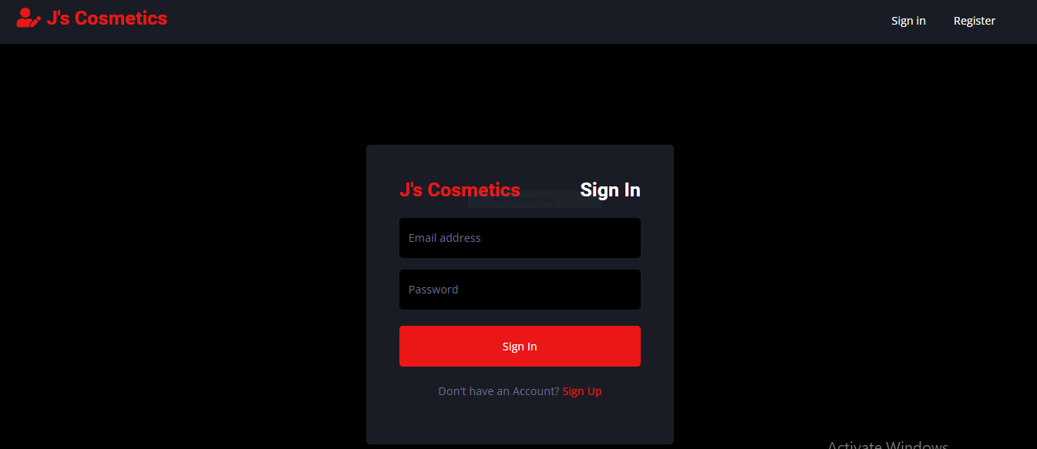
LOGIN

Slide 7
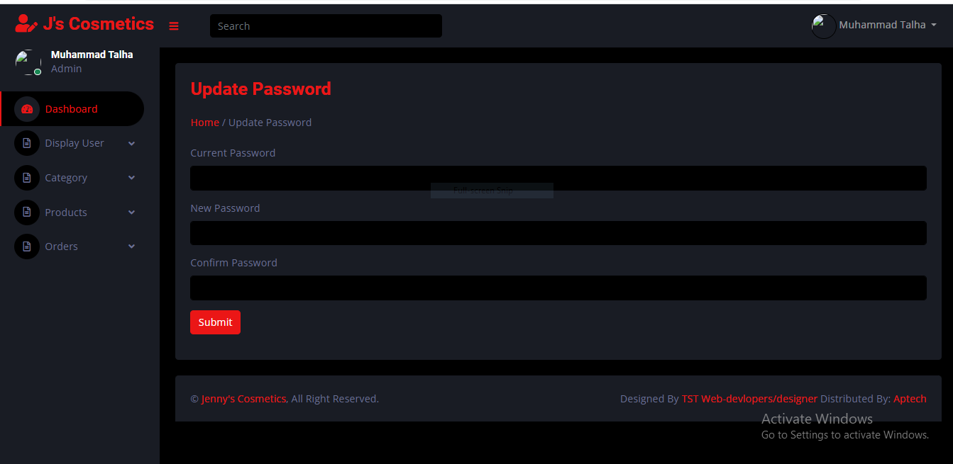
UPDATE PASSWORD

Slide 8
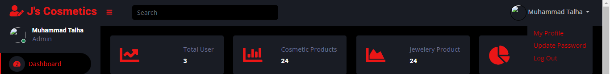
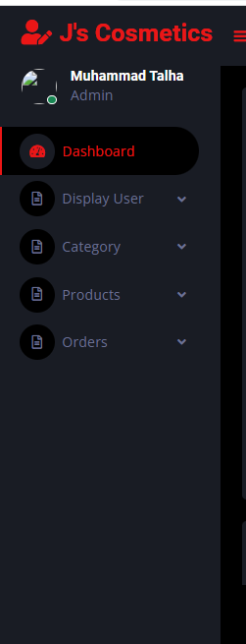
HEADER
SIDEBAR

Slide 9

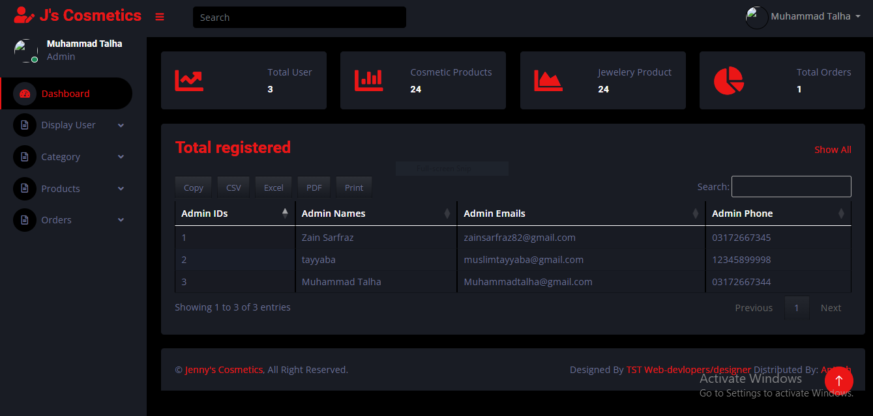
HOME

Slide 10
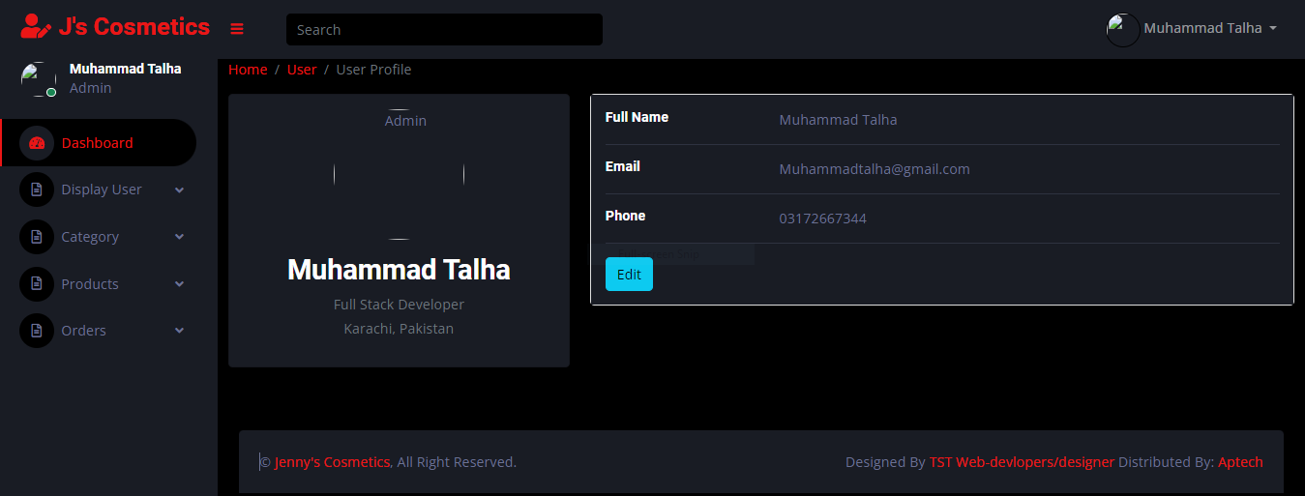
ADMIN PROFILE

Slide 11

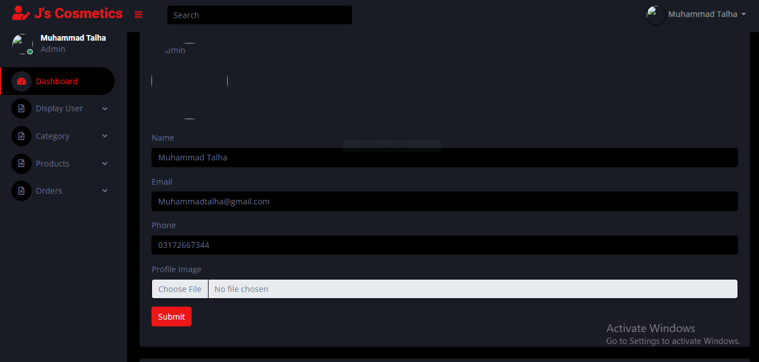
UPDATE PROFILE

Slide 12
Thankyou

